Slide 1
Transforming and Analyzing Data
with SQL
Sarah Ajayi
17th May, 2023

Slide 2
SETTING UP E-COMMERCE DATABASE
To derive accurate and meaningful insights that would drive informed business decisions and outcomes.
Analysis would be derived from these tables:
All_sessions
Analytics
Products
Sales_by_sku
Sales_report

Slide 3
Problems
Null values
Missing values
Duplicate records
Inconsistent data
Outliers (negative/astronomical values)

Slide 4
Data Cleansing & Table Alteration
All_sessions_table
Dropped empty attributes
Analytics table
Dropped empty attributes
Deleted duplicate records from the analytics table with
Unit price regularized by dividing by 1,000,000
Zerorized negative values in units sold
Products table
Null values in numerical fields changed to 0
Limitations: Time constraint - Pagetitle has special characters in 4 records that needs to be translated or cleaned.
Standardized the currency code (USD) for consistency
Limitation: Technical difficulties - too much time to delete using row_number partition, so new table created.
“CREATE TABLE analytics_dup AS SELECT DISTINCT * FROM analytics_clean”
Dropped duplicate attributes
Updated null values in numerical fields to 0
Updated null values in categorical fields to “Unknown” e.g country, city

Slide 5
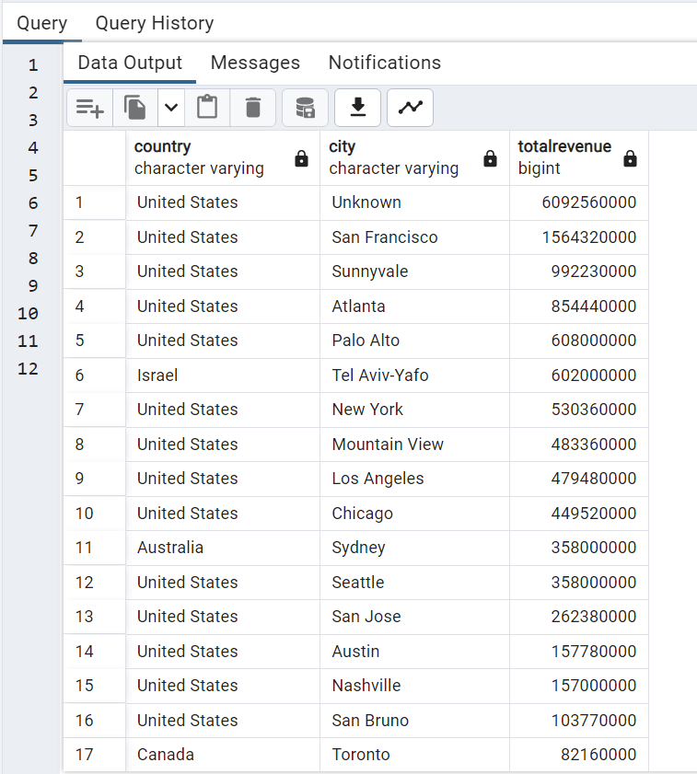
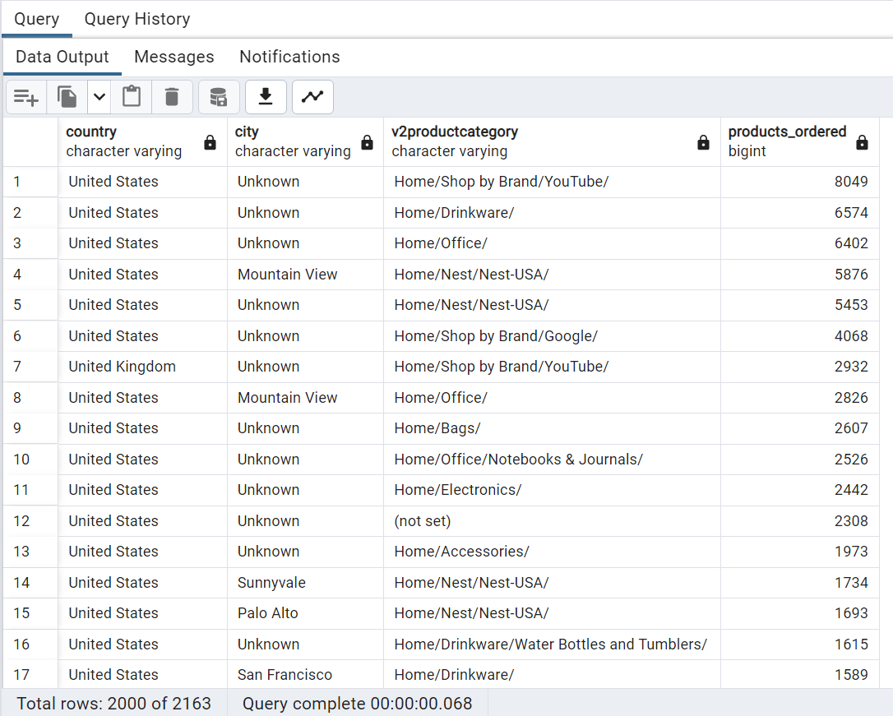
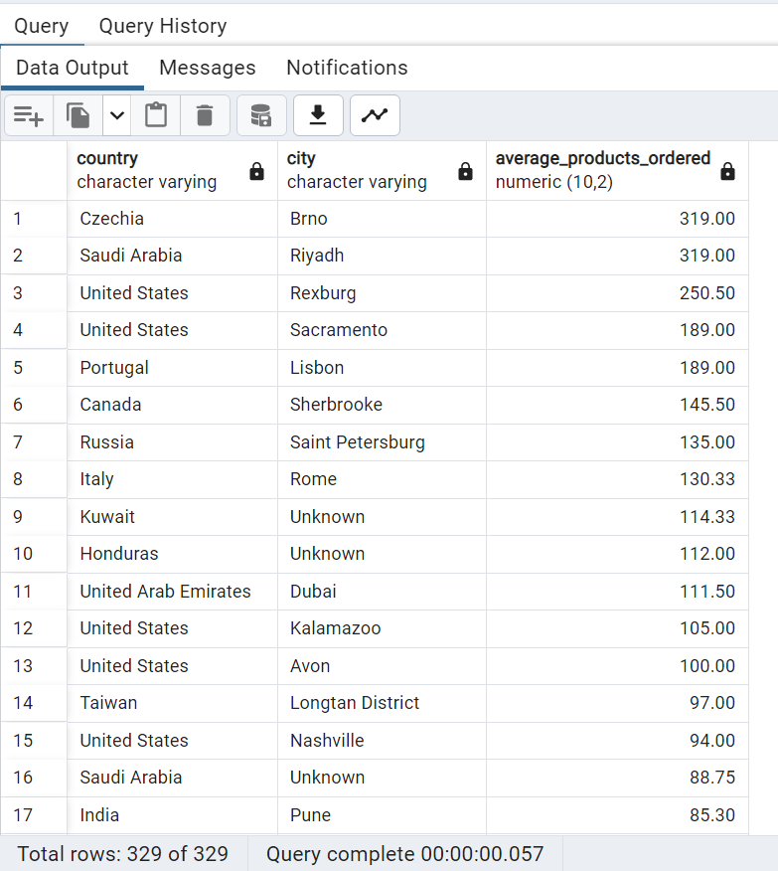
Insights
Revenue Drivers
Q: Cities and countries with the highest level
of transaction revenues on the site
Pattern in the types (product categories) of products ordered from visitors in each city and country
The average number of products ordered from
visitors in each city and country

Slide 6
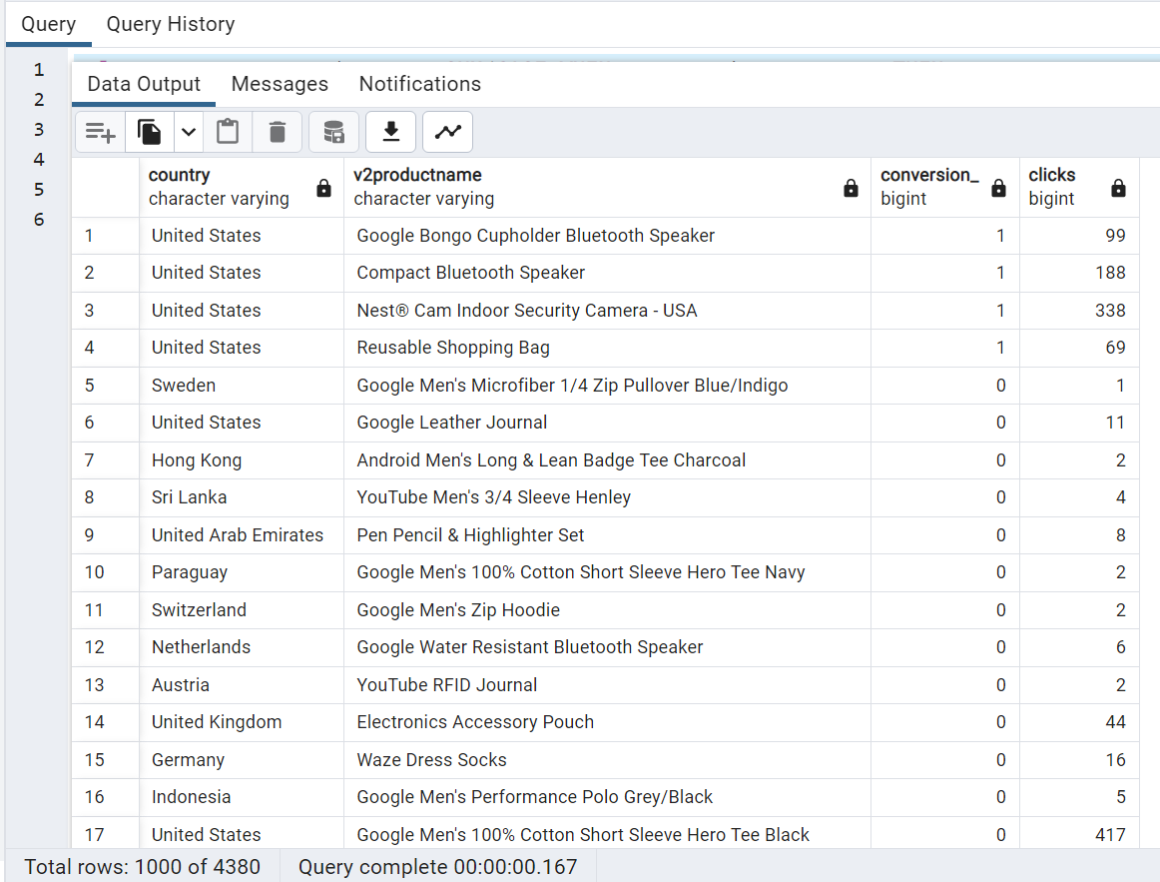
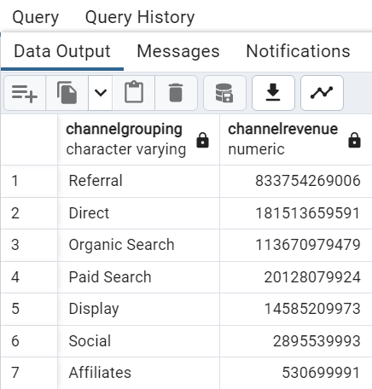
Further Insights
Revenue-Generating Channel
Q: The channel that generates the highest revenues
Site interaction and Conversion
Q: Ascertain the number of siteclicks and conversion by product and country

Slide 7

QA Process/Validation
Data Profiling - Analyzed the schema and documented data quality issues as earlier mentioned
Data Validation – Checking for outliers, duplicate records/attributes, inconsistent data
Data Cleaning
Testing – Ensuring data cleansing is complete and compare output to expected values
Count Validation
Sum Validation
Average Validation
Min and Max Validation
Existence Validation

Slide 8
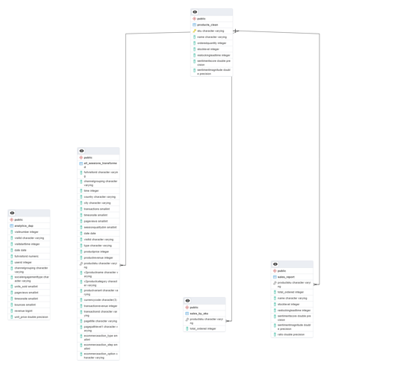
ERD
ERD
Products Table – sku(PK)
All_sessions – productsku (FK)
Sales_by_sku - productsku (FK)
Sales_report- productsku (FK)

Slide 9
1. There is a total of 293,537 units sold in the analytics table out of which 230,436 is without revenue. It would be nice to know if they are promo products and create a table the displays the attributes (promo_units) for better analysis. 3. Cannot have a keys in the all)sessions and analytics table – composite keys did not work
What is next?

